Slide 1
Pilots, Surgeons and Developers Improving Application Security With Checklists
Joe Kuemerle / @jkuemerle

Slide 2
“ ...the volume of what we know has exceeded our individual ability to deliver its benefits correctly, safely, or reliably. Knowledge has both saved us and burdened us.
That means that we need a different strategy for overcoming failure, one that builds on experience and takes advantage of the knowledge people have but somehow also makes up for our inevitable human inadequacies. And there is such a strategy - though it will seem almost ridiculous in its simplicity, maybe even crazy to those of us who have spent years carefully developing ever more advanced skills and technologies.
It is a checklist.”
Atul Gwande - The Checklist Manifesto
@jkuemerle

Slide 3
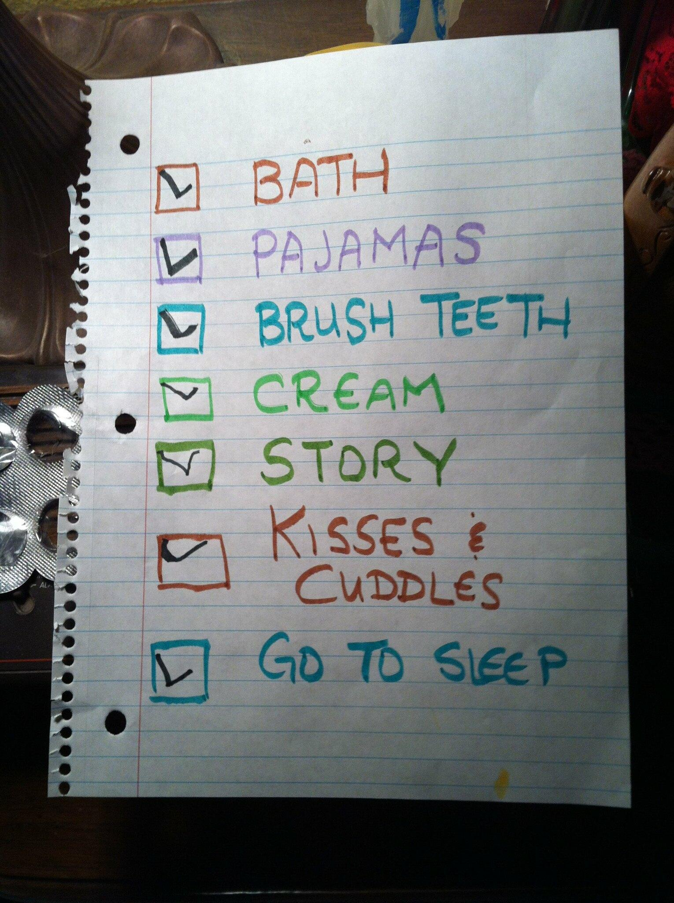
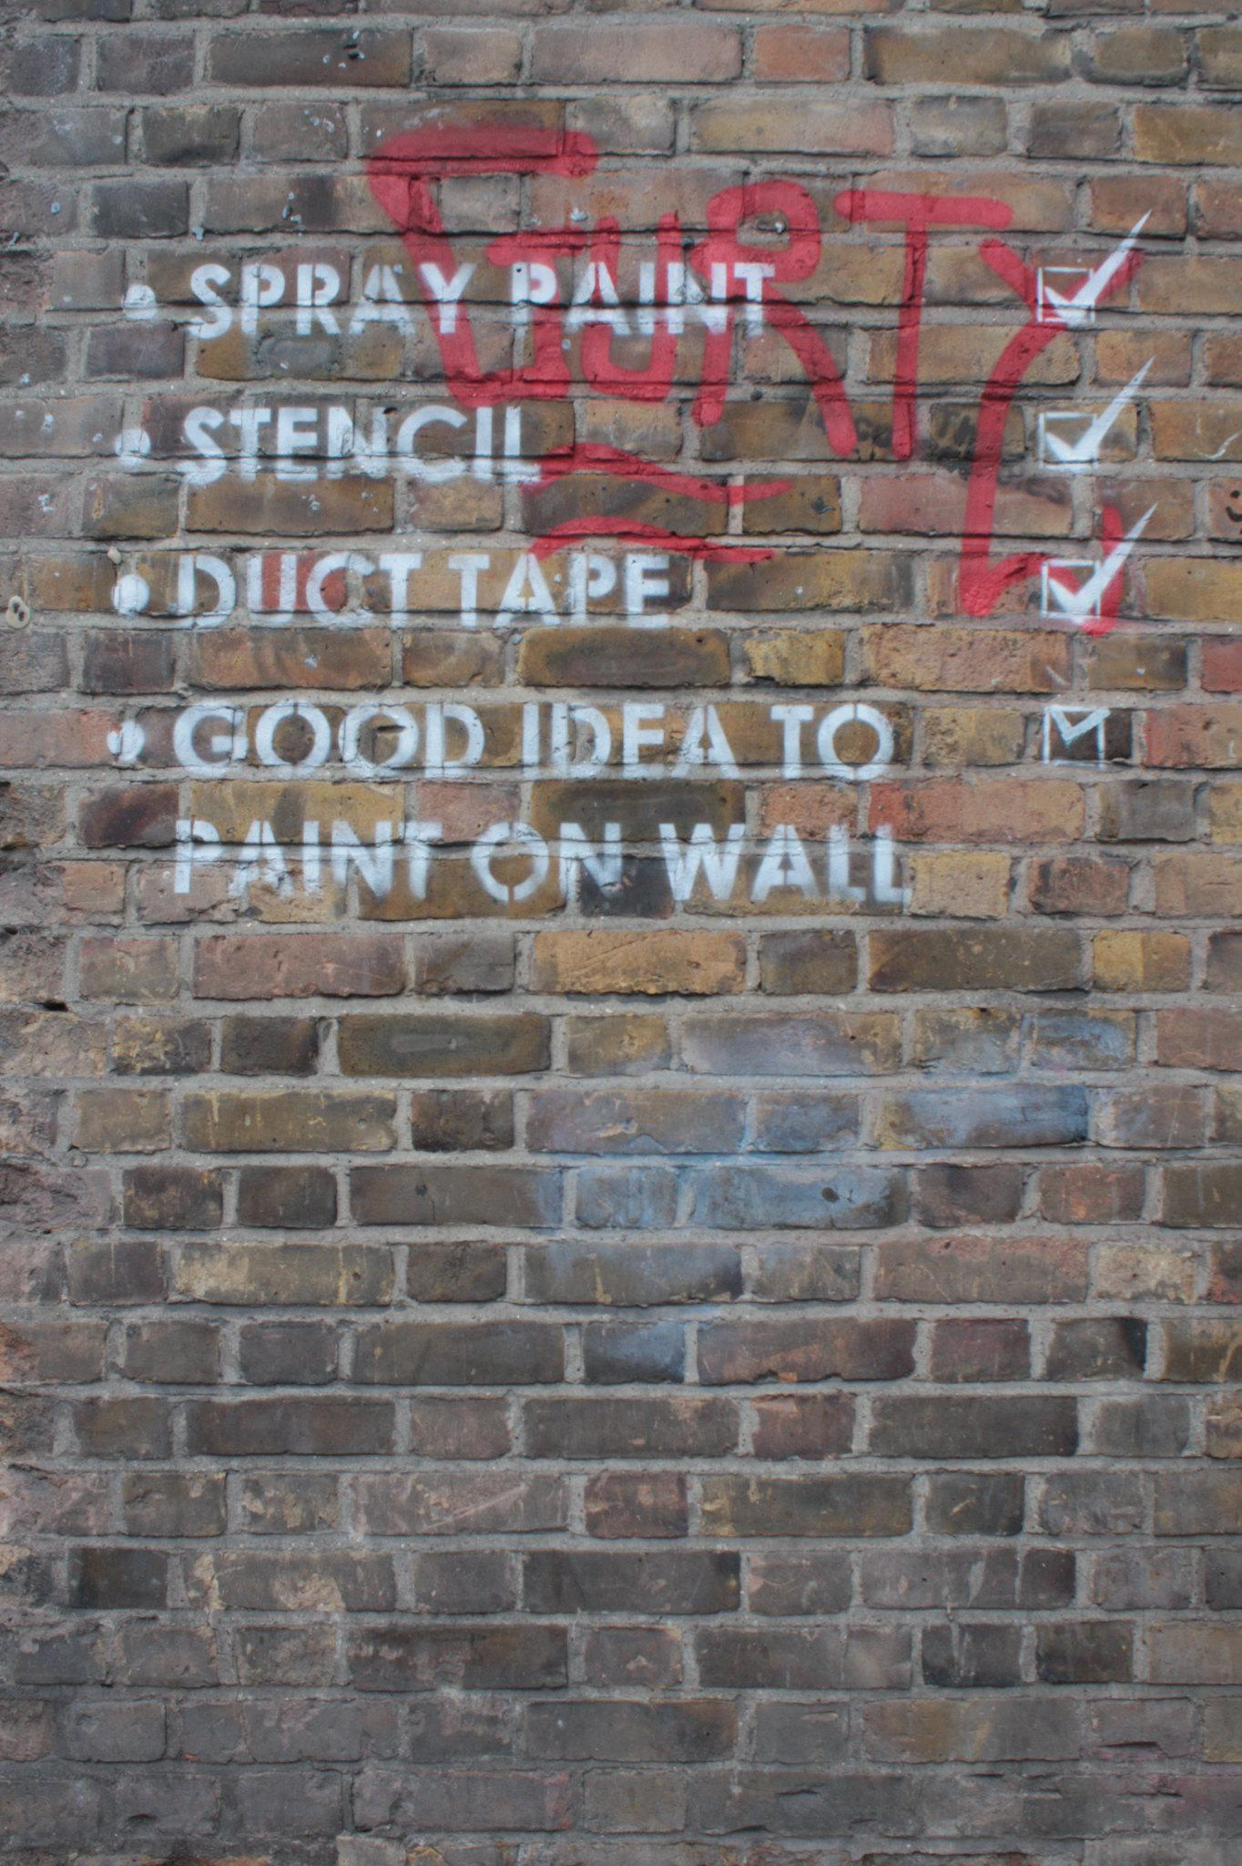
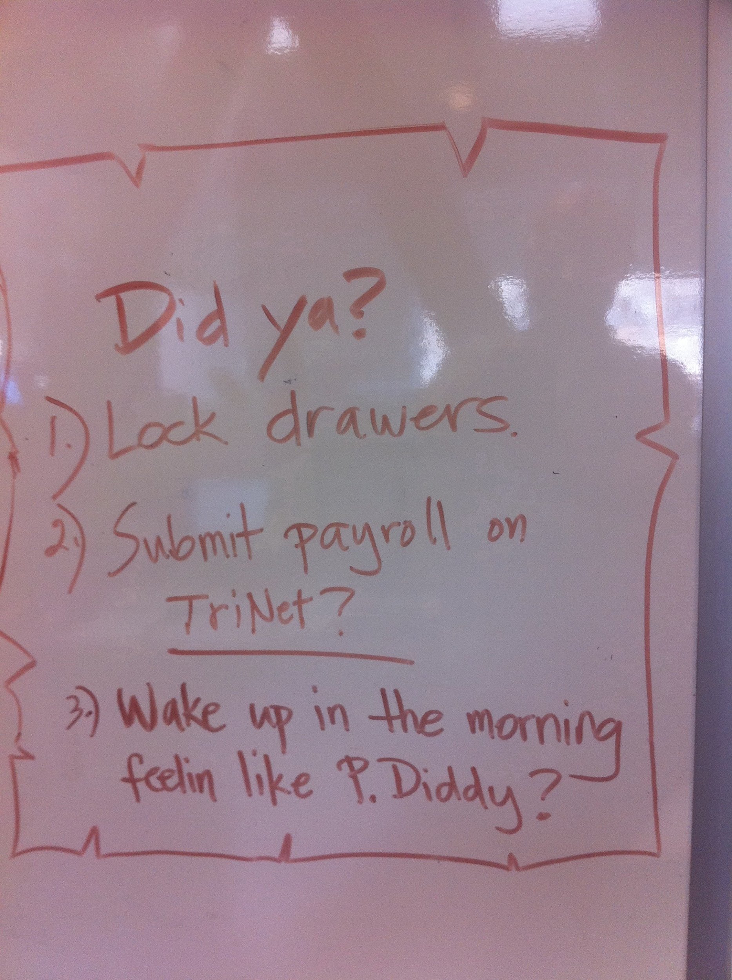
https://www.flickr.com/photos/89306448@N00/5331464979
https://www.flickr.com/photos/30963564@N00/8443668738
https://www.flickr.com/photos/65097875@N07/7381685460
@jkuemerle
Notes:
Definitions - what is a checklist. A set of simple, straightforward easy to assess criteria.

Slide 4

https://upload.wikimedia.org/wikipedia/commons/b/b1/Harry_Potter_1st_USA_ed._complete_hardback_set_stacked_with_ruler_horizontal.JPG
@jkuemerle
Notes:
Opposite of a heavy process document

Slide 5
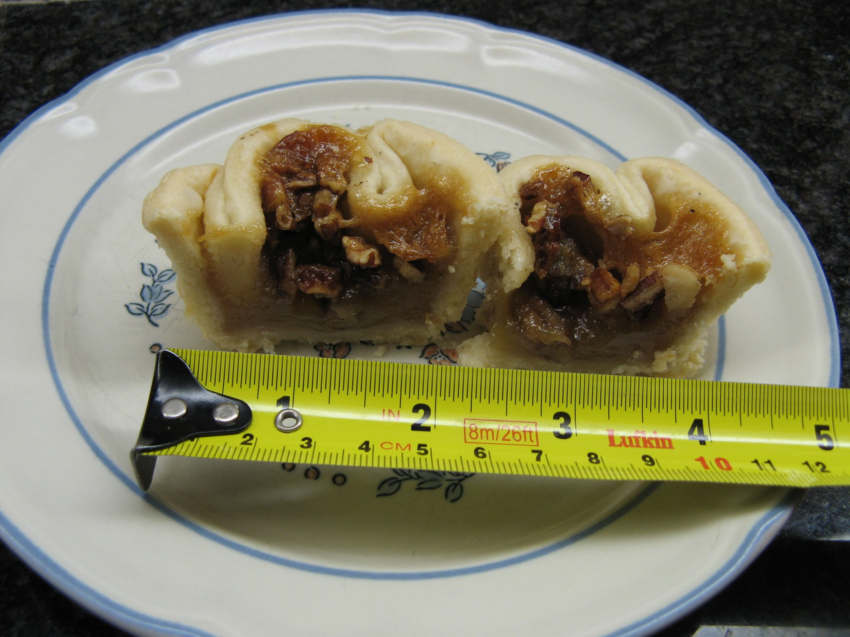
https://www.flickr.com/photos/45394900@N00/2812395984
@jkuemerle
Notes:
Do checklists work? Indicators of effectiveness - measurement of results shows actual improvement

Slide 6
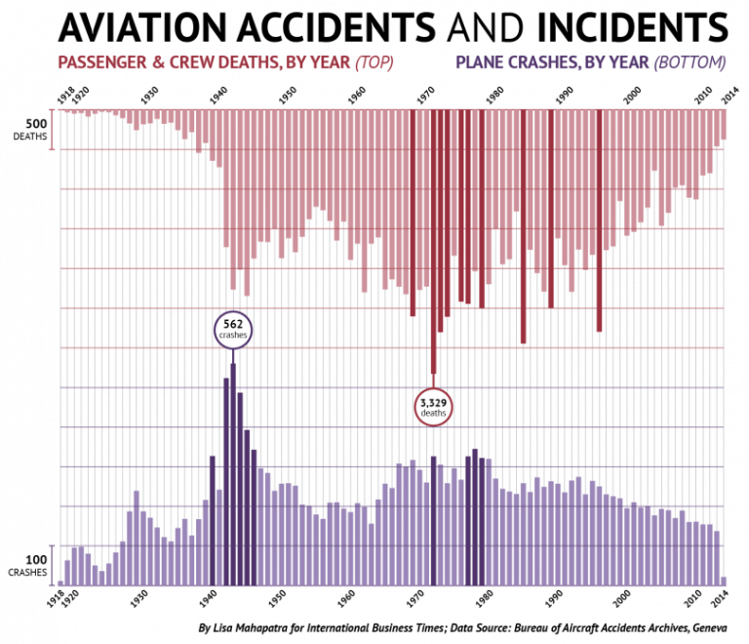
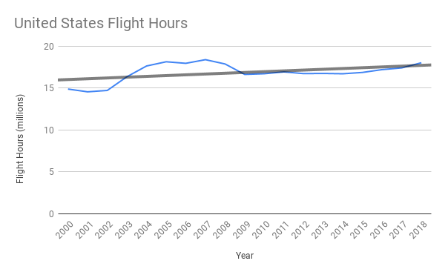
https://www.transtats.bts.gov/TRAFFIC/
Lessons We Can Learn From Aviation Checklists
https://blog.safetyculture.com/checklist-best-practices/lessons-we-can-learn-from-aviation-checklists
@jkuemerle
Notes:
Benefits - aviation

Slide 7
“Use of the WHO Surgery Checklist reduced the rate of deaths and surgical complications by more than one-third across all eight pilot hospitals.
The rate of major inpatient complications dropped from 11% to 7%, and the inpatient death rate following major operations fell from 1.5% to 0.8%.”
A surgical safety checklist to reduce morbidity and mortality in a global population New England Journal of Medicine 2009
@jkuemerle
Notes:
Benefits - medicine

Slide 8
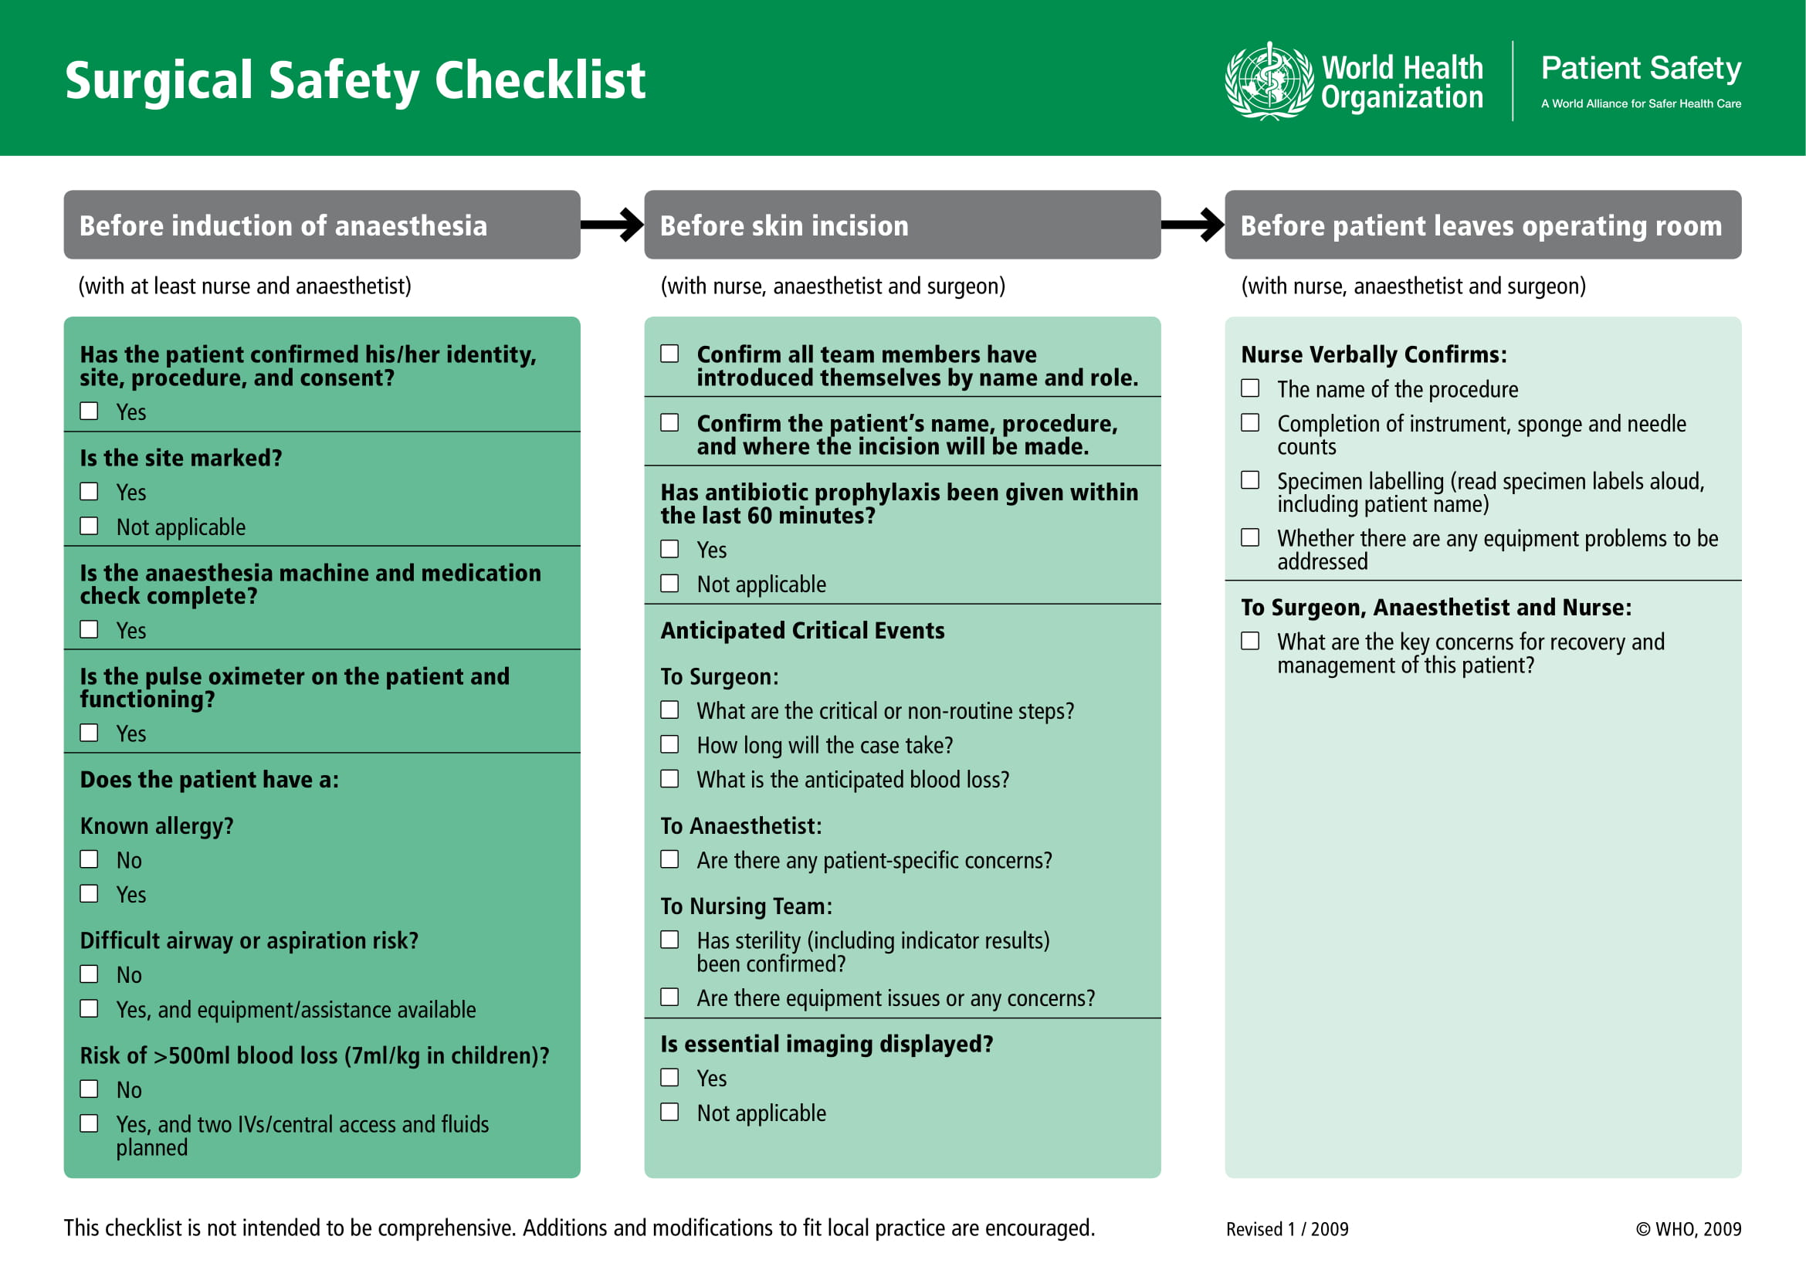
https://apps.who.int/iris/bitstream/handle/10665/44186/9789241598590_eng_Checklist.pdf
@jkuemerle
Notes:
WHO surgery checklist

Slide 9
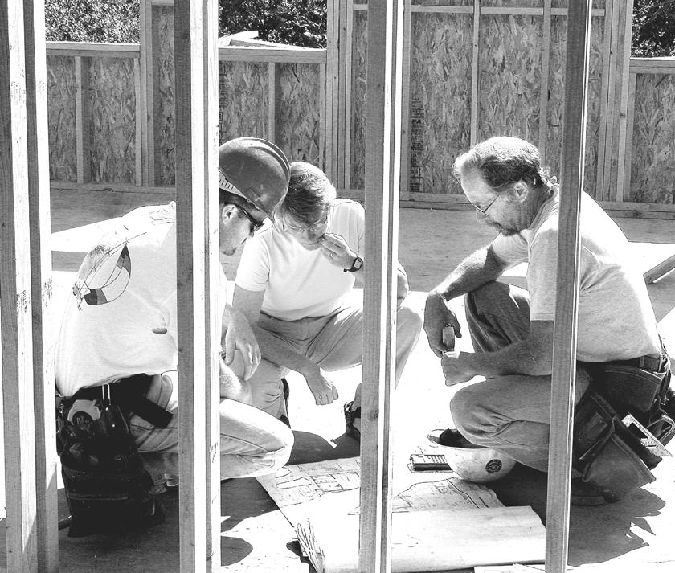
https://www.flickr.com/photos/21597369@N06/2091577071
@jkuemerle
Notes:
Development
Ground rules
Multiple checklists for different areas
Basic questions
Situational questions

Slide 10
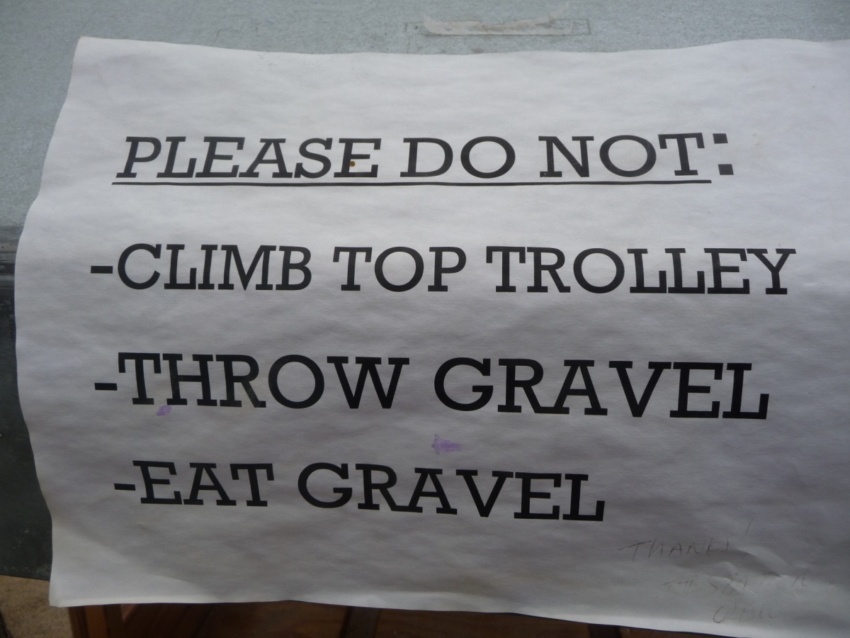
https://www.flickr.com/photos/81434653@N00/4597488208
@jkuemerle
Notes:
Ground Rules

Slide 11
“We believe that normal checklists are intended to achieve the following objectives:
Provide a standard foundation for verifying aircraft configuration that will attempt to defeat any reduction in the flight crew's psychological and physical condition.
Provide a sequential framework to meet internal and external cockpit operational requirements.
Allow mutual supervision (cross checking) among crew members.
Dictate the duties of each crew member in order to facilitate optimum crew coordination as well as logical distribution of cockpit workload.
Enhance a team concept for configuring the plane by keeping all crew members “in the loop.”
Serve as a quality control tool by flight management and government regulators over the flight crews.
Another objective of an effective checklist, often overlooked, is the promotion of a positive “attitude” toward the use of this procedure. For this to occur, the checklist must be well grounded within the “present day” operational environment, so that the flight crews will have a sound realization of its importance, and not regard it as a nuisance task (Nagano, 1975). ”
Cockpit Checklists: Concepts, Design, and Use
https://ti.arc.nasa.gov/m/profile/adegani/Cockpit%20Checklists.pdf
@jkuemerle
Notes:
Checklist ground rules and objectives
Checklists should be standardized, run in a logical order, provide a framework for communication and encourage collaboration
Teams should have a sense of buy in

Slide 12
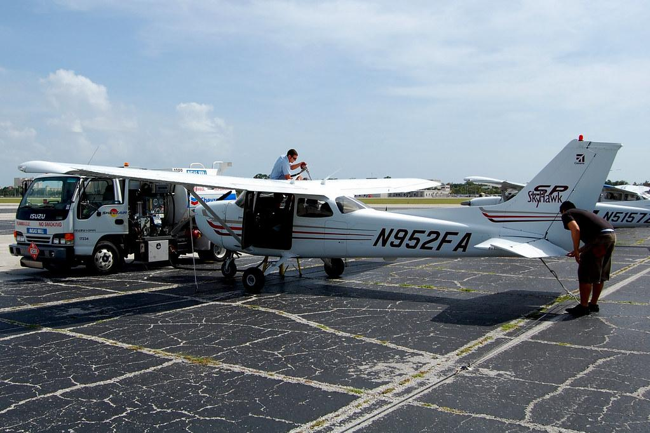



https://www.flickr.com/photos/30490214@N03/3778118025
https://www.flickr.com/photos/58611670@N04/12034754536
https://www.flickr.com/photos/34534185@N00/6052621788
https://www.flickr.com/photos/33104187@N04/28669836291
@jkuemerle
Notes:
Multiple checklists for different areas (preflight, takeoff, in flight/approach, landing)

Slide 13

https://www.flickr.com/photos/33104187@N04/19405783446
@jkuemerle
Notes:
Basic Questions
Common to many platforms/scenarios/applications. Covers regular ongoing circumstances

Slide 14
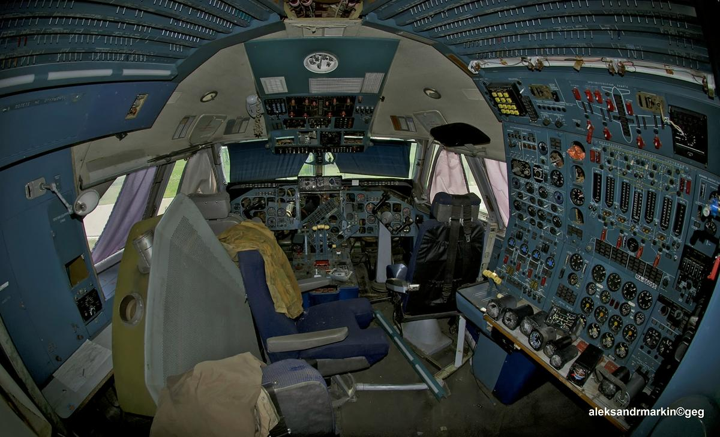
https://www.flickr.com/photos/33104187@N04/9294538702
@jkuemerle
Notes:
Situational Questions
More complex scenarios requiring detailed work (sensitive data, crypto, etc), incident response, bug bounty/0-day

Slide 15
“The various ways of conducting a checklist are influenced not only by the checklist device and the method of using it, but also by its “philosophy of use.” This philosophy varies among airframe manufacturers, officials of regulatory agencies, and airlines. In most cases, the checklist philosophy of use is the outgrowth of the company’s corporate culture.
…
The airline’s culture is an important factor because it is mirrored in the manner in which flight management and training departments establish, direct, and oversee flight operations and related procedures ... ”
Cockpit Checklists: Concepts, Design, and Use
https://ti.arc.nasa.gov/m/profile/adegani/Cockpit%20Checklists.pdf
@jkuemerle
Notes:
Implementation: collaboration
Effectiveness of checklists is partly from increased open communication
Customize for your own use - story about British NHS and how they give anesthesia prior to entering the operating room

Slide 16
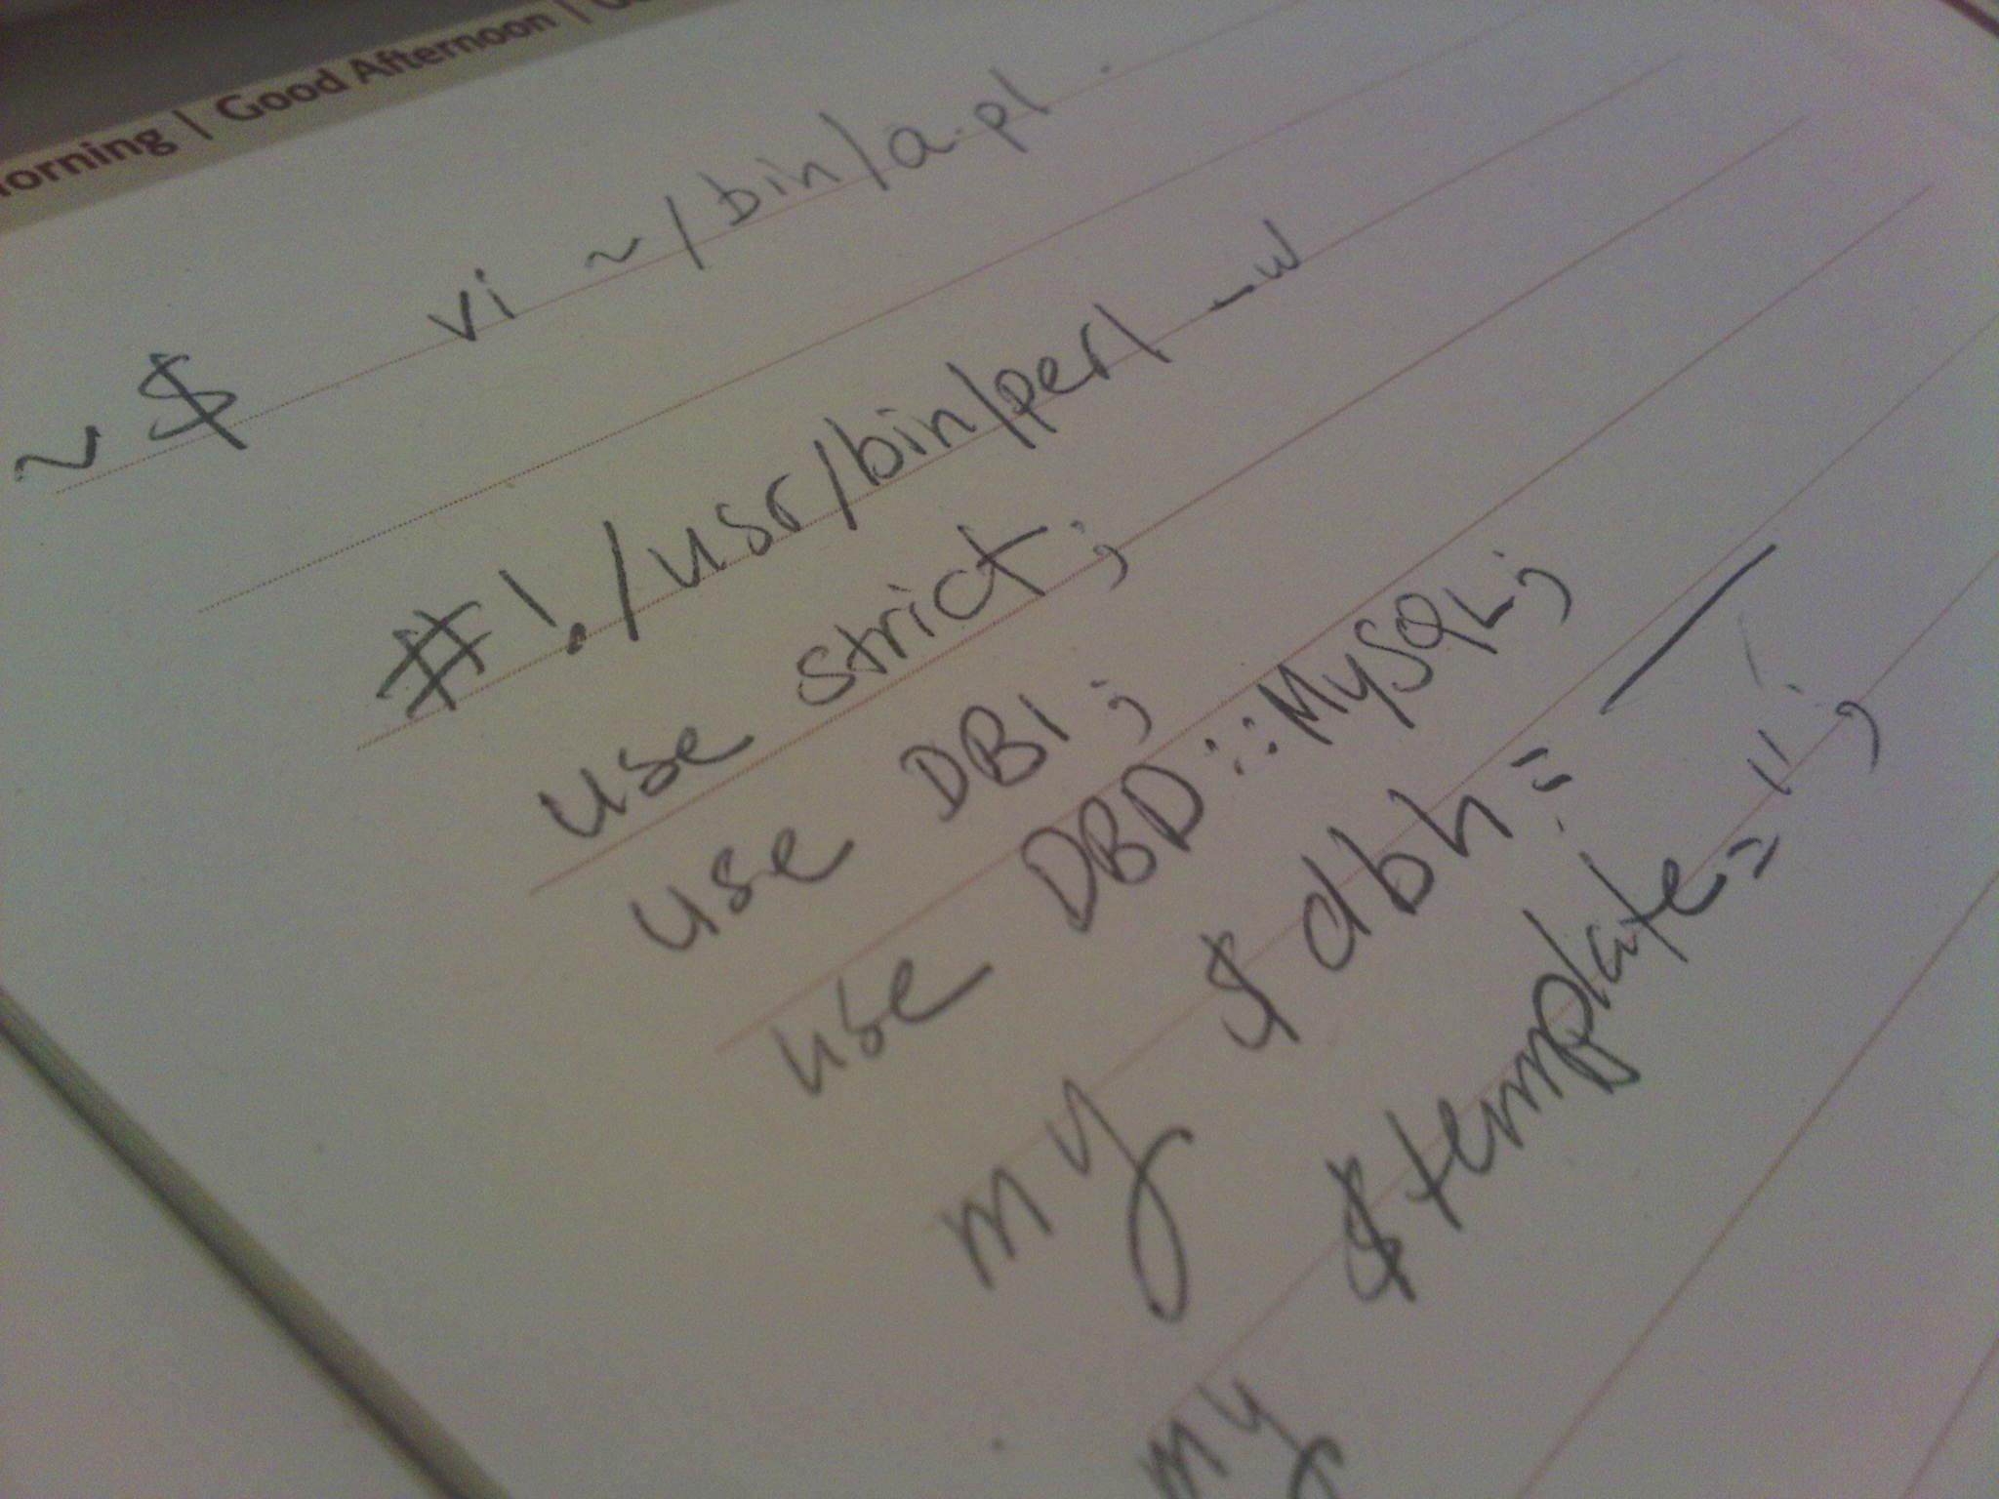
https://www.flickr.com/photos/9461373@N05/5472232343
@jkuemerle
Notes:
Developer collaboration
Communication with developers is key. They are the main users of checklists and must feel both encouraged to use them and empowered to tweak them
One of the major benefits with communication and collaboration is personalization and getting to know each other. People who don’t know one another's names don’t work well together. Even just an introduction of names and roles showed improvements in the results of surgical teams, including the increased likelihood of staff members to call out potential complications

Slide 17
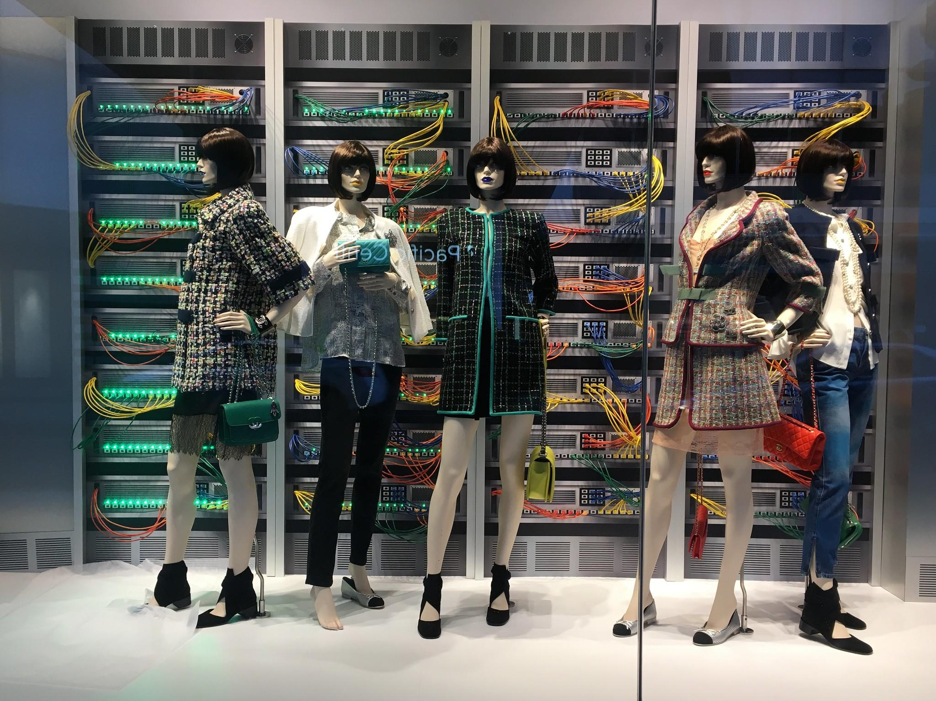
https://www.flickr.com/photos/37996646802@N01/33471651681
@jkuemerle
Notes:
Operations collaboration
Having a checklist the includes operations can help with day to day operations as well as incident response.
Checklists can also facilitate knowledge of people and roles across groups, leading to increased communication and improved incident responses

Slide 18
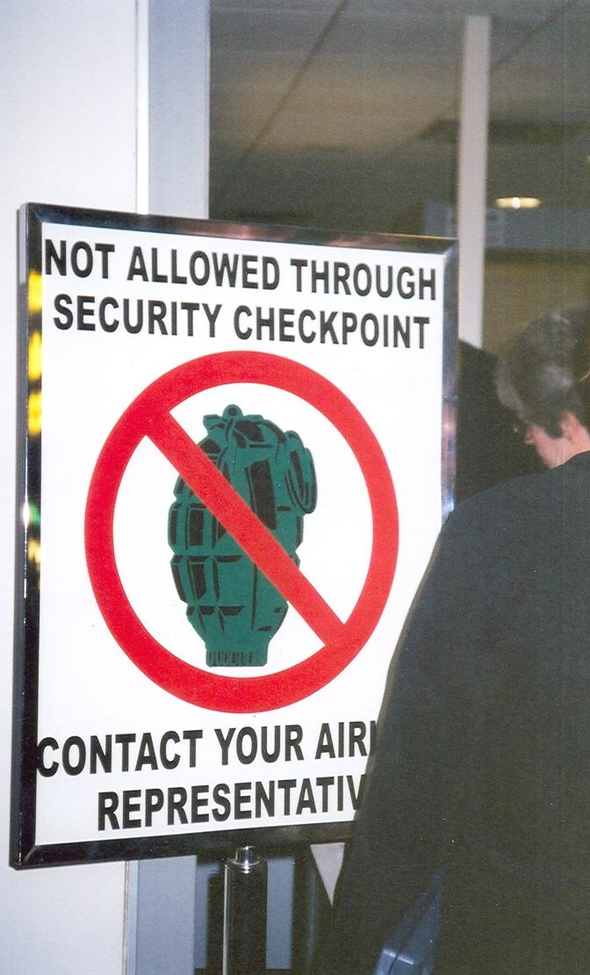
https://www.flickr.com/photos/77846644@N00/112869208
@jkuemerle
Notes:
Security collaboration
Collaborating with security provides personalization and putting faces to roles. Security can be seen as more than just someone who comes in at the last minute and says “no”

Slide 19
“Management pressure for “on-time performance” is one factor that yields high operating efficiency. Air transports fly in and out of hubs with fast turnarounds. The Department of Transportation monitors flight schedules in order to publish the highest and lowest ranking airlines in “on-time performance,” placing another public relations burden on management. Such production pressures ultimately migrate into the cockpit, and consequently affect checklist management.
The checklist procedure is highly susceptible to production pressures. These pressures lay the foundation for errors by encouraging sub-standard performance when the crew is rushing to complete the checklist in order to depart on time. Furthermore, under production pressures, checklists are sometimes ‘...relegated to second place status in order to save time’”
Cockpit Checklists: Concepts, Design, and Use
https://ti.arc.nasa.gov/m/profile/adegani/Cockpit%20Checklists.pdf
@jkuemerle
Notes:
Management collaboration

Slide 20

https://www.flickr.com/photos/37914686@N00/2928818748
@jkuemerle
Notes:
Antipattern: length

Slide 21
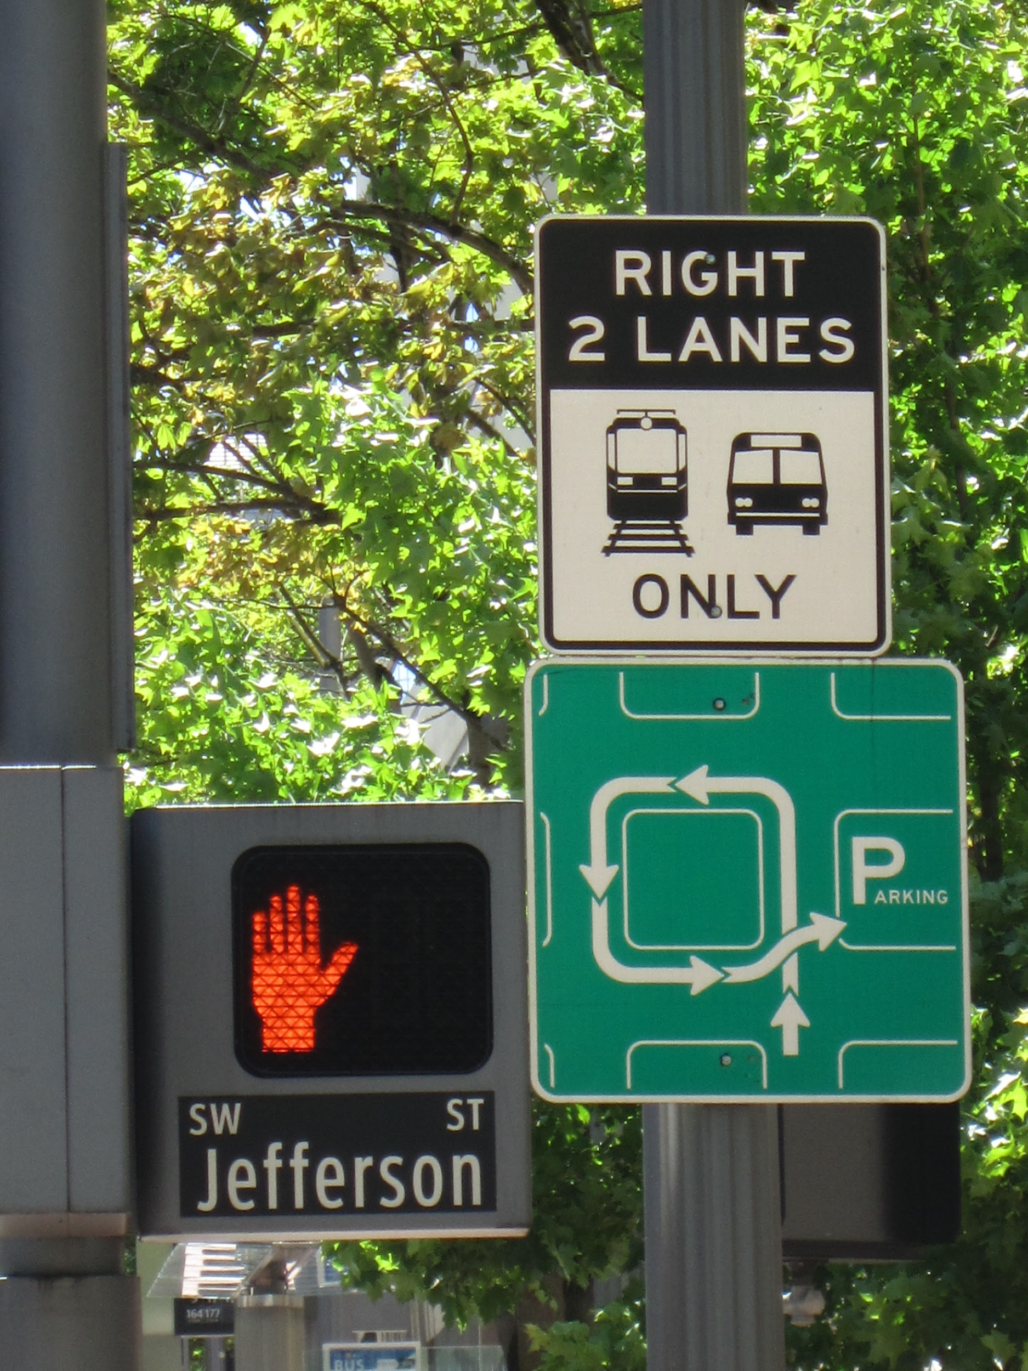
https://www.flickr.com/photos/84987970@N00/8736519237
@jkuemerle
Notes:
Antipattern: complexity

Slide 22

https://www.flickr.com/photos/51339554@N08/9585802912
@jkuemerle
Notes:
Antipattern: applicability (relevance)

Slide 23
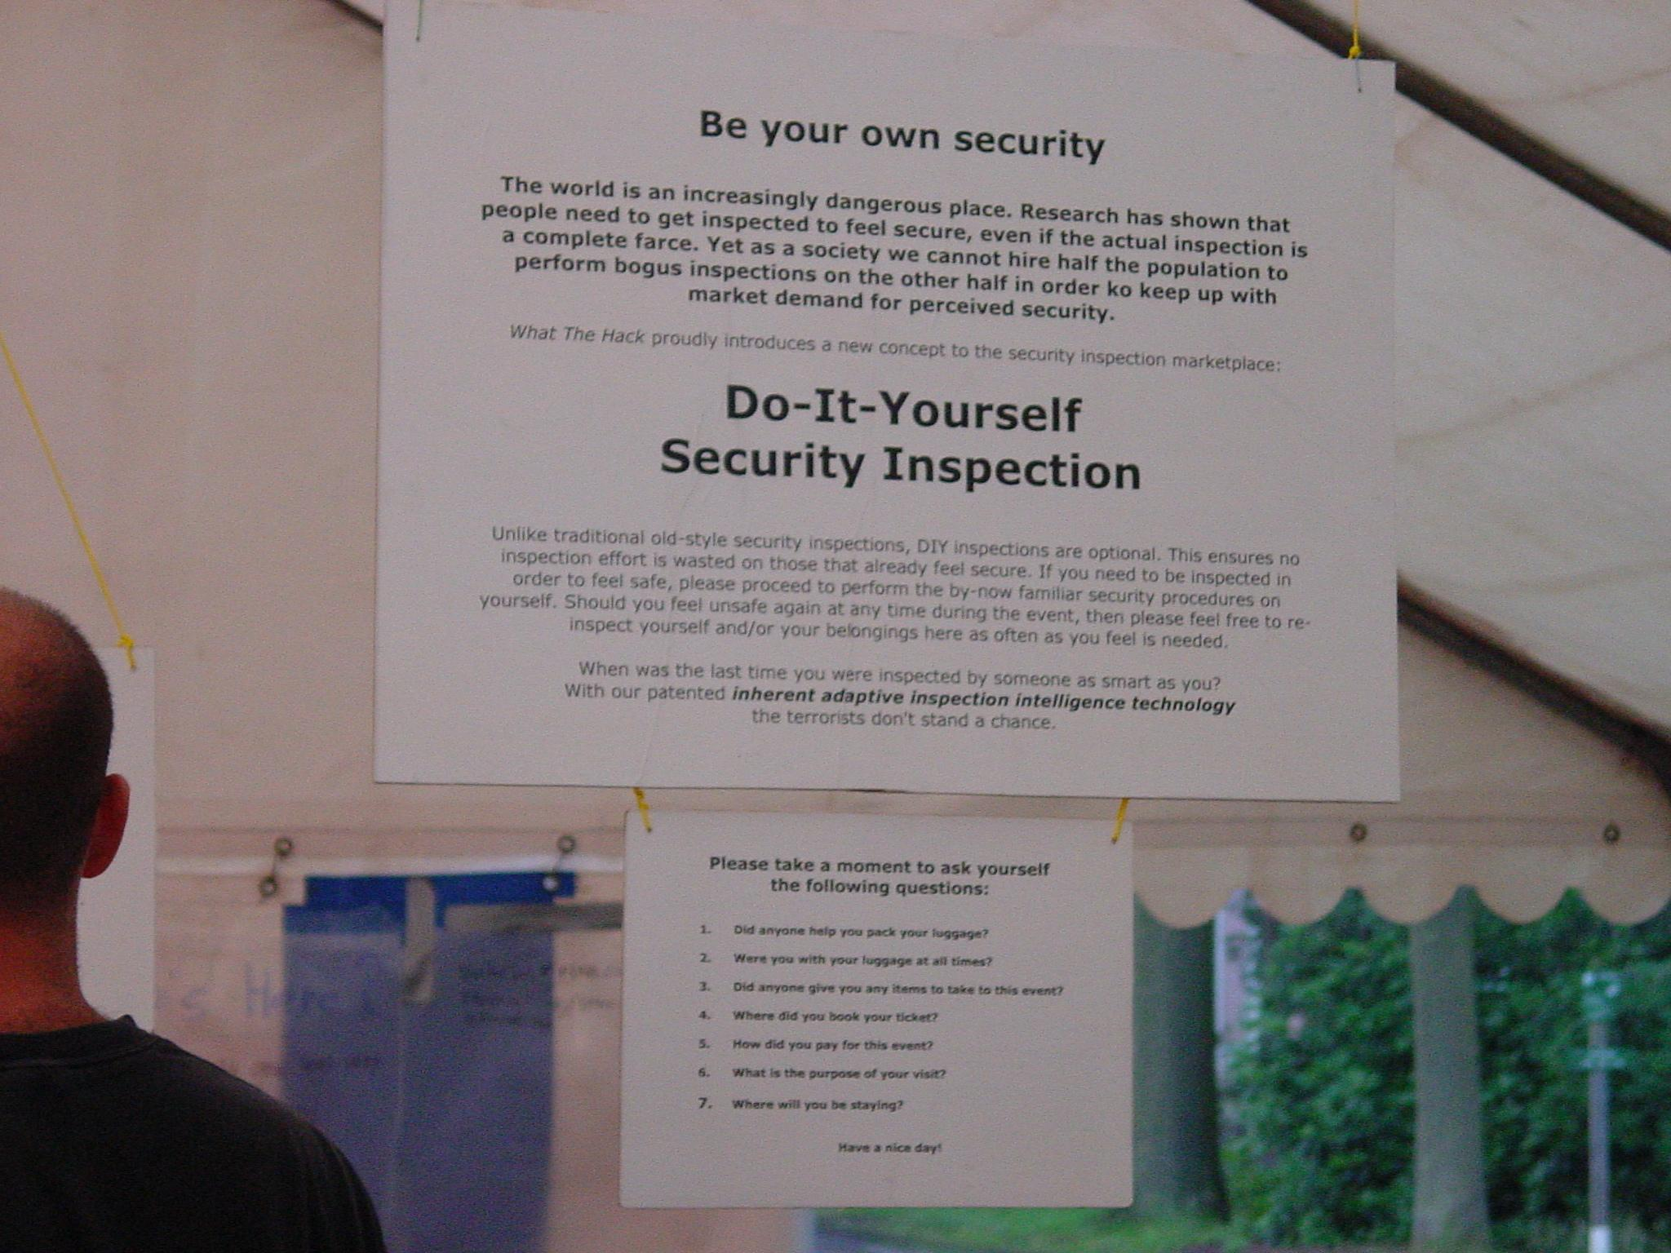
https://www.flickr.com/photos/26747023@N00/34607366
@jkuemerle
Notes:
Measuring effectiveness
How to measure security output?
One proxy can be developer interaction and relationship with security

Slide 24
Am I allowing the user to change the value of stored data?
☐ No
☐ Yes, and I am making sure the user is both identified and is authorized to make the requested changes
Am I exposing an internal identifier value to the user?
☐ No
☐ Yes, and I am making sure the user is both identified and is authorized to view or work with the item
Am I returning any values that the user entered back to the user?
☐ No
☐ Yes, and I am making sure the values are escaped for the rendering context
Am I processing any user provided XML data?
☐ No
☐ Yes, and I am using an XML parser that is configured to reject embedded document type declarations (DTD)
@jkuemerle
Notes:
Sample checklist items

Slide 25
1. Checklist responses should portray the desired status or the value of the item being considered, not just “checked” or “done.”
☐ Items all have status indicating desired value
2. A long checklist should be subdivided to smaller task-checklists or chunks that can be associated with systems and functional areas.
☐ Checklist is subdivided according to task specific areas
3. Sequencing of checklist items should follow a meaningful organization of the tasks, and be performed in a logical flow.
☐ Checklist items are in a logical order
4. Checklist items should be sequenced in parallel with internal and external activities that require input from other parties (operations, project/product management, stakeholders)
☐ Items that require external input are in parallel
5. The most critical items on the task-checklist should be listed as close as possible to the beginning, in order to increase the likelihood of completing the item before interruptions may occur. This could conflict with No. 4 above. In most cases where this occurs, this guideline should take precedence.
☐ Critical items are listed as close as possible to the top
6. Critical checklist items that need to be reevaluated due to new information, should be duplicated in checklists for the appropriate situation (testing, runtime, etc.).
☐ Items requiring reevaluation are duplicated where appropriate
7. The completion call of a checklist should be written as the last item on the checklist, allowing team members to move mentally from the checklist to other activities with assurance that the checklist has been completed.
☐ Checklist ends with a completion task
8. Critical checklists should be completed early in the process in order to decouple them from the other activities that may cause distraction.
☐ Critical checklist is documented to be completed first
9. Checklists should be designed in such a way that their execution is not tightly coupled with other tasks. Provide buffers for recovery from failure and a way to “take up the slack” if checklist completion does not keep pace with other activities.
☐ Checklists do not have tightly coupled tasks
10. Teams should be aware that checklist procedure is highly susceptible to production pressures. These pressures set the stage for errors by possibly encouraging substandard performance, and may lead some to relegate checklist procedures to a second level of importance, or not use them at all.
☐ Development has a sense of ownership of checklists
@jkuemerle
Notes:
Guidelines (interactive building session)

Slide 26
References
The Checklist Manifesto - Atul Gawande http://atulgawande.com/book/the-checklist-manifesto/
Hidden Brain Podcast: You 2.0: Check Yourself https://www.npr.org/2018/08/27/642310810/you-2-0-check-yourself
Cockpit Checklists: Concepts, Design, and Use
https://go.nasa.gov/32LGFrO
Human Factors of Flight-Deck Checklists: The Normal Checklist https://bit.ly/HumanFactorsChecklists
A Surgical Safety Checklist to Reduce Morbidity and Mortality in a Global Population (NEJM) https://bit.ly/SurgicalSafetyStudy
Safe Surgery (WHO) https://www.who.int/patientsafety/safesurgery/en/
Notes:
References

